Slide 1


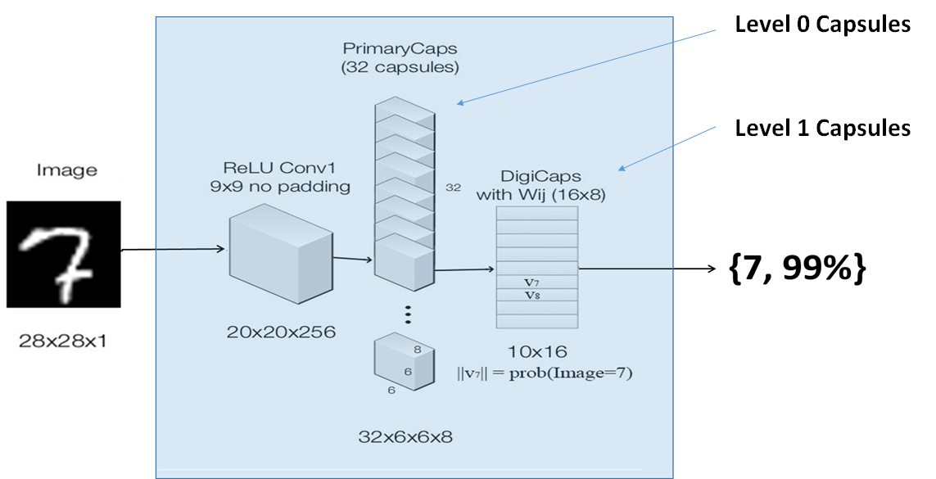
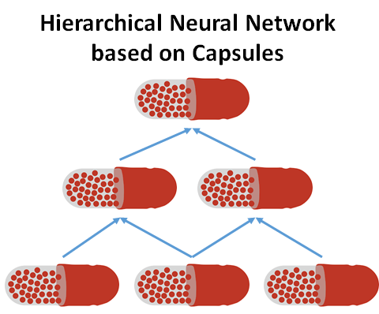
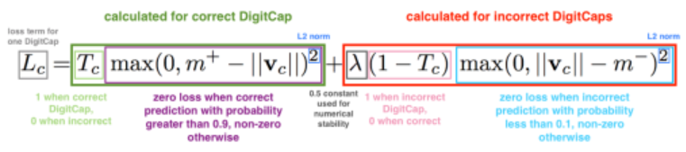
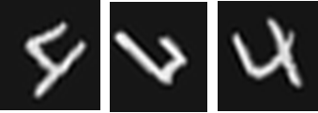
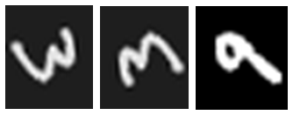
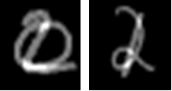
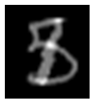
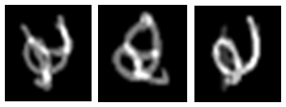


Hierarchical Neural Network
Suresh Sugumar
ssugumar@stanford.edu
CS230
Deep Learning
Spring 2019
Motivation
Architecture & Model
CNN Pooling layer results in poor translational invariance
CNN gets easily fooled on adversarial images, with the image with eyes deformed and dislocated, CNN still output a human face
Goal is to build a new NN that is as good as CNN, and have better translational invariance qualities
Capsule proposed by Hinton et., al. is a good candidate to build a hierarchical network for this purpose, and we shall compare the performance against CNN
Loss Function
Implemented capsule network architecture with dynamic routing in tensorflow/ keras and trained with MNIST
Data & Features
Training is strictly performed on MNIST standard train dataset, and no augmented dataset has been trained
Apart from the standard MNIST dataset, we generated additional 500+test images to test the translational invariance quality of both CNN and Capsule based HNN
Rotation operation examples
Overlap operation examples
Results
Discussion & Future
Capsule network performed equally well against CNN on standard MNIST database without any augmentation
With augmented test data (rotation and overlaps), clearly capsule network outperformed the CNN predictions
Capsule based hierarchical neural networks can perform image recognition tests better than CNN with a small training set
Training a capsule based network takes significantly larger time than with a CNN – this needs to be investigated
Test the capsule network on complex image processing application such as face recognition
Investigate if capsule concept can be applied to other forms of tasks such as voice recognition, text sentiment analysis, etc.
https://github.com/sureshsugumar/HierNet
https://youtu.be/TL81fI0X6vg
References:
1. Geoffrey E Hinton et., al. Dynamic Routing Between Capsules. arXiv:1710.09829, 2017.

